Slide 1

LEARN MORE TECHNOLOGIES
- UPASANA GUPTA
(working AS SAP Developer)

Slide 2
What is SAP?
SAP is one of the world’s leading producers of software for the management of business processes. It was founded in 1972. SAP, which stands for Systems, Applications, and Products in Data Processing, is a German multinational software corporation that is the world's largest vendor of enterprise resource planning (ERP) software.

Slide 3
Future in SAP
SAP is focused on future-proofing services through various initiatives, including the integration of AI capabilities into the SAP S/4HANA. This integration aims to help financial teams manage costs, reduce risk, and respond more quickly to changes in consumer sentiment. In addition, SAP is working to improve the efficiency of its development footprint management solution and to introduce a development data exchange functionality that will facilitate the exchange of standardized routine data with partners and suppliers. The company is also introducing industry-specific partnerships to increase supply chain flexibility. Moreover, SAP emphasizes the importance of moving into a highly connected world of cloud-based business communications and innovation for continued success over the next 50 years. The future of SAP automation is also promising, with the adoption of intelligent automation technologies such as the integration of machine learning and artificial intelligence is a key priority in the future of SAP automation, and they look expect the rise of cloud-based SAP to further change the way businesses operate

Slide 4
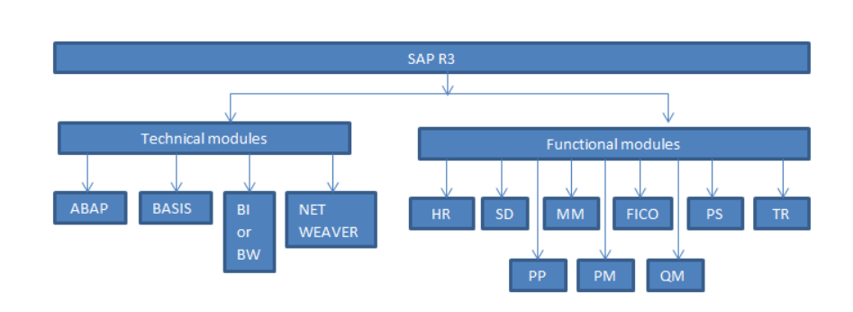
Different SAP Modules

Slide 5
What is SAP ABAP?
ABAP (Advanced Business Application Programming) is SAP's proprietary programming language, designed for developing business applications within the SAP ecosystem. It is a fourth-generation language (4GL) that supports procedural, object-oriented, and event-driven programming paradigms. ABAP is primarily used for creating reports, interfaces, forms, data conversions, and custom enhancements in SAP systems.
Key Features of ABAP
ABAP is an event-driven language, meaning its execution is controlled by user actions or system events. It supports multi-paradigm programming, allowing developers to use procedural and object-oriented approaches. ABAP programs can run alongside other languages like Java or JavaScript, making it versatile for integration.
The language has evolved significantly, with modern versions like ABAP 7.4 and 7.5 introducing features such as enhanced Open SQL syntax, Core Data Services (CDS) views, and ABAP Managed Database Procedures (AMDP). These updates reduce code complexity and optimize performance, especially for SAP HANA.

Slide 6
Responsibilities for SAP ABAP developer
Support project development needs, in particular within work streams of Matters Management and Finance, relative to Professional Services Implementation of SAP S4/HANA.
Participate with customer business and functional team in design workshops / requirements gathering
Work with functional and other teams to understand business requirements and translate into technical specifications and solutions in accordance with client standards and architecture
Ability to design and develop EDI standards and EDI/IDOC data mapping
Track and fully document change to ensure that issue logs are clearly documented and articulated
Perform end user training internal cross training to other team members as necessary
Understand user and process requirements and ensure those requirements can be achieved through high quality deliverables within the SAP landscape
Design, code and correct large and/or complex programs and program modifications as custom development, or within an existing application
Understand which requirements can be achieved through customizing, system development or enhancements
Define test cases and run unit tests on developed, or modified system changes

Slide 7
What is ERP software?
ERP stands for “enterprise resource planning.” ERP software includes programs for all core business areas, such as procurement, production, materials management, sales, marketing, finance, and human resources (HR).
SAP was one of the first companies to develop standard software for business solutions and continues to offer industry-leading ERP solutions.

Slide 8
Introduction to SAP R/3 Architecture
SAP based the architecture of R/3 on a three-tier client/server model.
Presentation Server
Application Server
Database Server

Slide 9
1. Presentation Server
The presentation server consists of an application called sapgui.exe. It is often installed on the user's workstation. To launch it, the user double-clicks an icon on the desktop or selects a menu route. When started, the presentation server shows the R/3 menus in a window. This window is also known as the SAP GUI. The interface takes input from users in the form of keystrokes, mouse clicks, and function keys, which it then delivers to the application server for processing. The application server returns the results to the SAPGUI, which prepares the output for presentation to the user.

Slide 10
2. Application Server
An application server is a collection of executables that understand ABAP/4 applications and handle their input and output. When an application server is started, all of the programs launch at the same time. When an application server is stopped, they all shut down simultaneously. The number of processes that start when you launch the application server is configured in a single configuration file known as the application server profile.
Each application server has a profile that sets its behavior when it loads up and when it is functioning. For example, an application server profile describes:
The number and types of processes.
Processes can consume different amounts of RAM.
The amount of time a user is inactive before being automatically logged off.
The application server exists simply to understand ABAP/4 applications; these programs do not operate on the presentation server. An ABAP/4 application can launch an executable file on the presentation server, but it cannot run there.

Slide 11
3. Database Server
The database server consists of the executable that receives database queries from the application server. These queries are sent to the Relational Database Management System (RDBMS). The RDBMS returns the data to the database server, which in turn delivers data back to the application server. The application server then sends the data to your ABAP/4 program.
The database server is often housed on a different computer, and the RDBMS may operate on the same machine or be installed on its own.

Slide 12
Discussing the SAP Three-Tier Client Server Architecture

Slide 13
Introduction to ABAP and Development Tools (SE80, SE38, SE11)
SE80 is a transaction code in SAP ABAP that stands for Object Navigator. It is a comprehensive tool used for developing and navigating various development objects within the SAP system. SE80 provides a hierarchical view of all the objects related to programming, classes, and other repositories such as MIME, object repository, and object browser
1. Development and Navigation: SE80 allows developers to create and navigate through programs, function groups, classes, and other development objects. It provides a tree structure that makes it easy to view and manage these objects.
2. Integrated ABAP Editor: SE80 includes an ABAP editor that enables developers to write and modify ABAP programs. While SE38 also provides an ABAP editor, SE80 offers additional features such as creating packages, module pools, BSP applications, and more.

Slide 14
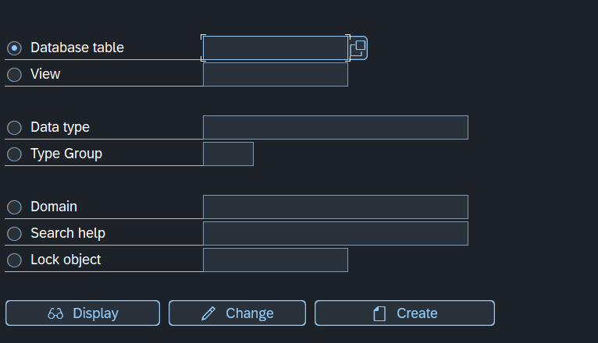
SE11 (ABAP Dictionary)- To open the initial screen of ABAP Dictionary, either select SAP Menu > Tools > ABAP Workbench > Development > ABAP Dictionary in the SAP Easy Access screen or simply enter the SE11 transaction code in the Command field present on the standard toolbar and press the ENTER key.

Slide 15
Continued…………..
3. Application Hierarchy: One of the overlooked features of SE80 is the ability to browse the application hierarchy. This feature allows developers to view ABAP development objects from a functional perspective, making it easier to find specific objects related to a particular business area.
4. Service Consumer Creation: SE80 can be used to create service consumers for web services. For example, you can create a new service consumer by choosing an external WSDL and activating the consumer proxy.

Slide 16
What is the R3 System?
The most basic definition of an R/3 system is "one database." In an R/3 system, there is only one database. To expand the concept, R/3 covers all of the components linked to a single database. One R/3 system consists of a database server that connects to a single database, one or more application servers, as well as one or more presentation servers. It is defined as all of the components associated with a single database. One database equals one system. Throughout an implementation, one system (or database) is often provided for development, one or more for testing, and one for production.

Slide 17
Important concepts of SAP ABAP Module
ABAP Transactions: ABAP transactions are used to customize pre-defined applications based on the needs of an organization.
BDC (Batch Data Conversion): Batch data conversion simplifies the movement of data from one SAP system to another, or from a non-SAP system to a SAP system.
SAP Scripts: SAP scripts and smart forms enable contact with business partners.
ABAP Reports: ABAP reports are used to create and generate SAP reports. Reports enable a firm to monitor daily sales and turnover etc.
ABAP Workbench: The SAP ABAP workbench is a set of tools for creating SAP application components. The major components of the workbench are

Slide 18
ABAP Dictionary
▪ ABAP Editor
▪ Class Builder
▪ Function Builder
▪ Screen Painter
▪ Menu Painter
▪ Object Navigator
▪ Maintain Message
▪ ABAP Text Elements
▪ Maintain Transaction

Slide 19
Creating a Database Table in SAP ABAP
To create a database table in SAP ABAP, follow these steps:
Step-by-Step Guide
Execute Transaction Code SE11: Enter SE11 in the SAP command field and press Enter.
Enter Table Name: In the "ABAP Dictionary: Initial Screen", choose the "Database table" radio button. Enter the table name starting with Y or Z (e.g., ZEMPLOYEE) and click on the "Create" button.
Maintain Table Details: In the "Dictionary: Maintain Table" screen, enter a short description for the table. Set the "Delivery Class" to A (Application table for master and transaction data). Choose "Display/Maintenance Allowed" from the dropdown for "Data Browser/Table View Editing".
Define Fields: Click on the "Fields" tab. Enter field details such as Field Name, Key, Data Type, and Length. Example: Field Name: EMP_ID Key: X Data Type: CHAR Length: 10
Save and Activate: Click on the save icon to save the table. Enter the package name or choose "Local Object". Press Enter to continue. To activate the table, go to "Goto -> Technical Settings" or use Ctrl+Shift+F9. In the "Dictionary: Maintain Technical Settings" screen, enter details like Data Class and Size Category. Save and activate the table by clicking on the activate icon (Ctrl+F3).

Slide 20
Example of creating Table
1. Execute SE11
2. Enter Table Name: ZEMPLOYEE
3. Short Description: Employee Details
4. Delivery Class: A
5. Data Browser/Table View Editing: Display/Maintenance Allowed
6. Fields:
EMP_ID (Key, CHAR, Length 10)
EMP_NAME (CHAR, Length 50)
7. Save and Activate

Slide 21
Creation Views in ABAP
In SAP ABAP, a view is a virtual table that provides a logical representation of data from one or more database tables. Unlike physical tables, views do not store data themselves but derive it dynamically from the underlying tables. They are used to simplify data access, minimize interfaces, and improve performance by summarizing or combining data.
Types of Views in ABAP
Database View: Combines data from one or more tables using an inner join. Used for reading data but does not allow data maintenance. Accessible via Open SQL and Native SQL.
Projection View: Focuses on specific fields from a single table, hiding unnecessary fields. Allows both reading and maintaining data. Does not create a corresponding object in the database.
Help View: Designed for search helps and uses an outer join. Combines data from multiple tables linked by foreign keys. Only supports reading data and cannot be accessed directly via SQL.
Maintenance View: Enables maintenance of data distributed across multiple tables using an outer join. Suitable for custom tables and allows editing of related tables together. Not accessible via SQL and is used for application-specific data maintenance.

Slide 22
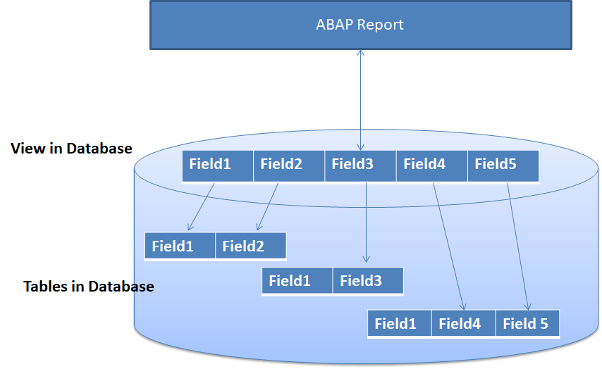

Slide 23
Key Features of Views
Logical Representation: Views act as a window to the data, summarizing or combining it without physically storing it.
Dynamic Updates: Changes in the base tables automatically reflect in the views.
Joins: Views use inner joins (Database View) or outer joins (Projection, Help, and Maintenance Views) to link tables.
Efficiency: Views reduce the complexity of accessing data spread across multiple tables.

Slide 24
Creating a View in ABAP
Navigate to transaction SE11 (ABAP Dictionary).
Select the "View" option and provide a name for the view.
Choose the type of view (e.g., Database View) and define the base tables and join conditions.
Specify the fields to include in the view.
Save and activate the view to make it available for use.

Slide 25
Use Cases
Database Views are ideal for reporting and data extraction.
Projection Views are used to simplify access to specific fields in a table.
Help Views enhance search functionalities in applications.
Maintenance Views are used for managing application-specific data across multiple tables

Slide 26
Creating Data Elements in SAP ABAP
To create data elements in SAP ABAP, follow these steps:
1. Accessing the Data Dictionary: From the SAP Easy Access page, choose “Data Dictionary” or enter the transaction number SE11 to get to the SAP Data Dictionary
2. Selecting the Right Type of Data Element: Choose the appropriate type of data element based on the data requirements
3. Entering Basic Data: Provide a unique name and a concise description for the data element
4. Determining Length and Type: Specify the length and data type (CHAR, NUMC, DATS, etc.)
5. Choosing a Domain: Select a domain for the data element to define the range of acceptable values.
6. Adding Documentation: Document the data element with thorough explanations and examples.

Slide 27
What is domain in SAP ABAP?
SAP ABAP domain is an object that specifies technical information of data type and length for a field. Domain determines sign, Lowercase, conversion routine, fixed values and value table. The existing domain can be used by multiple fields as per requirements instead of creating new domains in SAP.
Transaction code- SE11
SAP Menu Path SAP Menu > Tools > ABAP Workbench > Development > SE11 – ABAP Dictionary.

Slide 28
How to create Domain in SAP?
Step 1 : – Execute tcode “SE11” from SAP Command field.
Step 2 : – On ABAP Dictionary: Initial screen, provide the following details.
Domain : – Enter the name of domain that you want to create. The domain name should start with the letter Z or Y.
Create : – Click on create icon
Step 3 : – On Dictionary: change domain screen, provide the following details.
Short Description : – Provide the short descriptive text of domain.
Data type : – Point the cursor on data type field and press function key F4, now the possible entries displays on the screen. Choose the data type as CHAR (Character String).
No. Characters : – Provide the length of domain as 10. After maintaining all the required details for domain, press enter and click on save icon to save the data. Choose the local object from create object directory entry screen.
Step 4 : – After you create domain in SAP, you need to activate it. Choose activate icon or press (ctrl+F3) from your keyboard.
Successfully we have created domain in SAP ABAP.

